Slide 1


Notes:
Join the conversation here: http://discuss.hashicorp.com

Slide 2
hugs@hashicorp.com | learn.hashicorp.com | discuss.hashicorp.com

Slide 3

Revolutionizing Cloud Infrastructure Deployment: Unleashing the Power of Integration
~Aniket Kumar Sinha

Slide 4

Aniket Kumar Sinha
Cloud Consultant @ Rapid Circle
@aniketksinha

Slide 5



Notes:
Challenges in Juggling between GitHub Actions and Terraform Cloud? Managing separate pipelines at two different platforms. Benefits of TFC?
Collaboration and Teamwork
Remote State Management
Secure Credentials Management
State Locking and Lock Management
Managed Agents and Workspaces
Security and Compliance

Slide 6
🤝
Notes:
Integration Nirvana

Slide 7
+
Notes:
Integration Nirvana Steps:
TFC workspace creation
Token creation
Adding token as Secret
Creating main.tf file
Adding Azure SPN related info in TFC workspace variables
Creating workflow

Slide 8
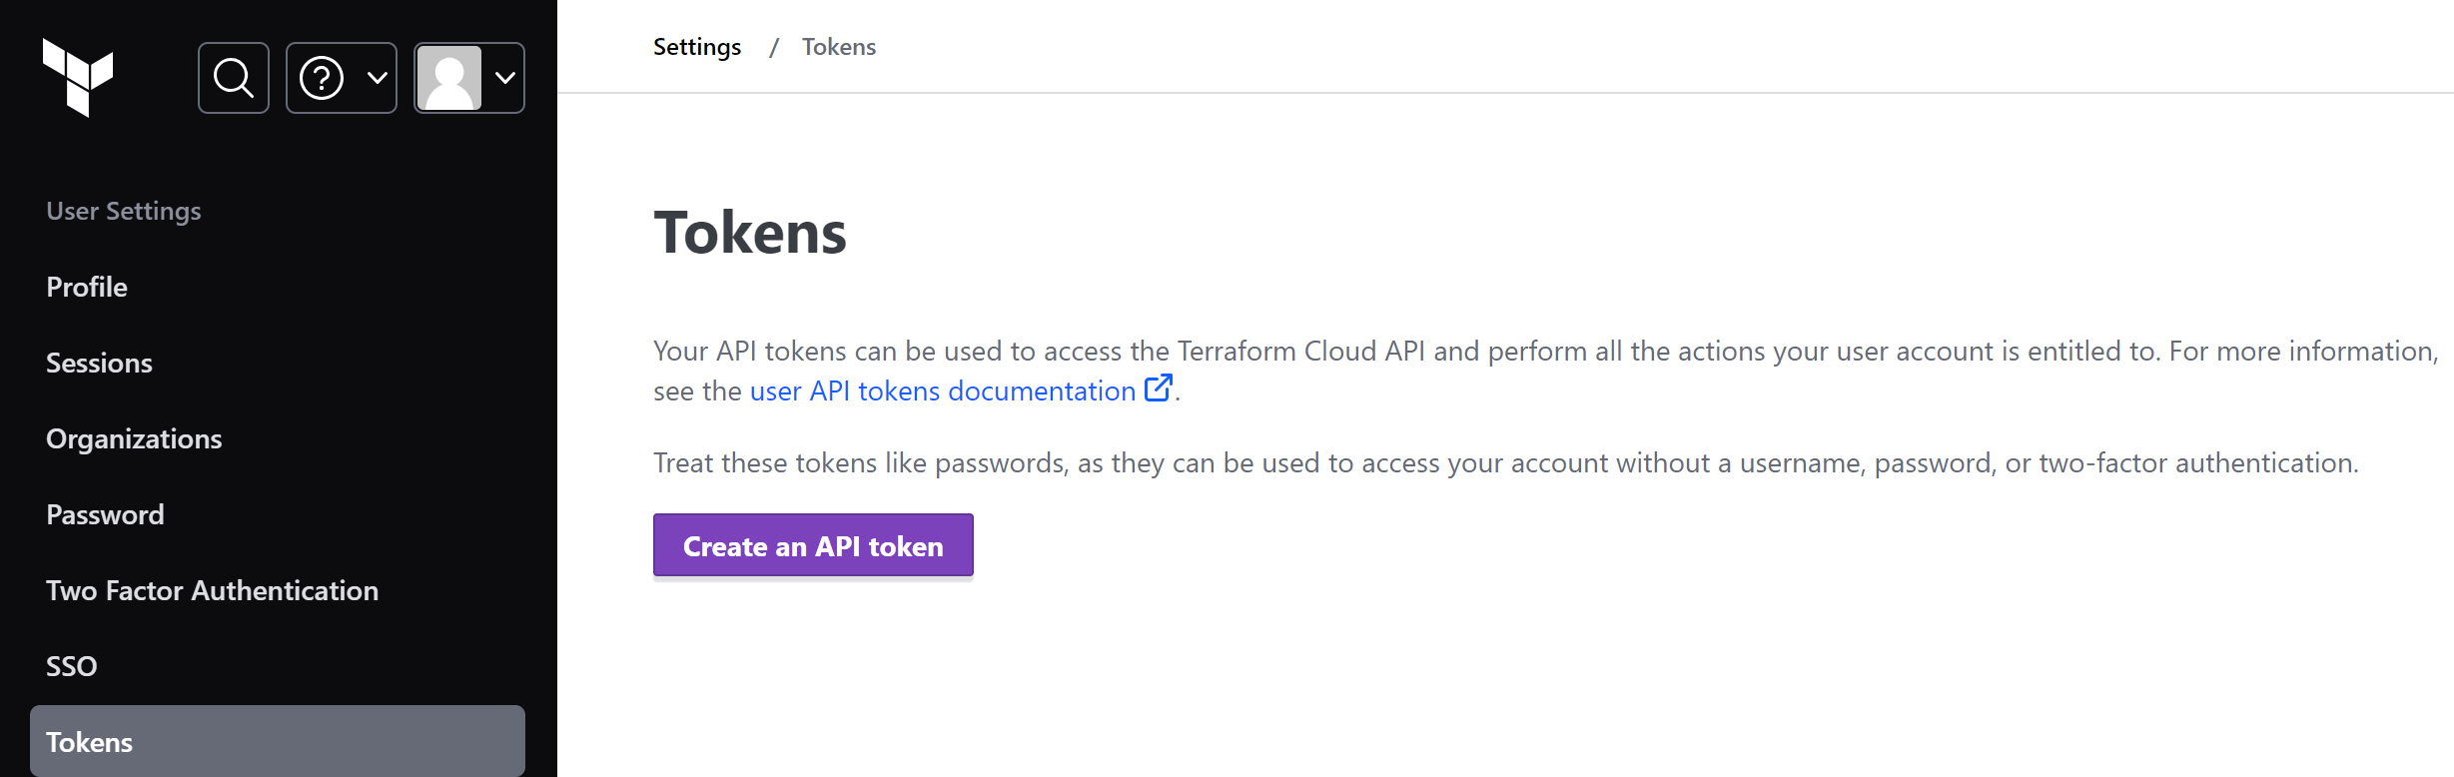
Integration Nirvana Steps
Create Terraform Cloud Workspace with API-driven Workflow.
Create new User API token from User Settings page.

Slide 9
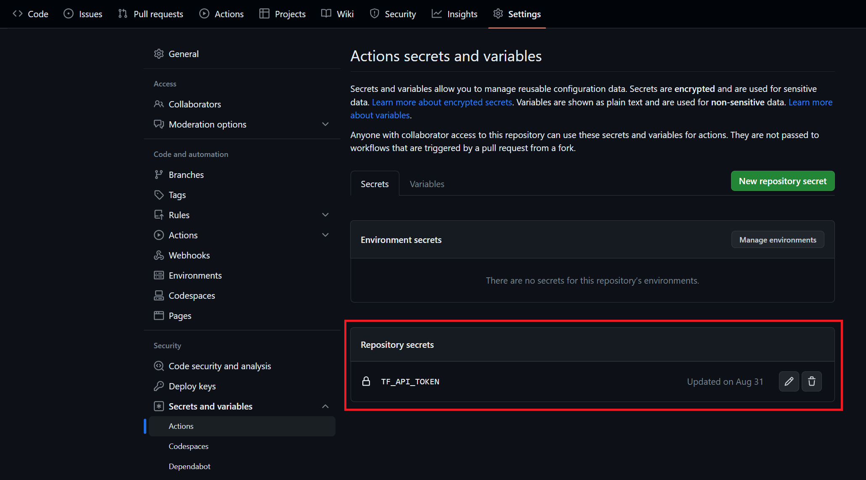
Integration Nirvana Steps
Add the API token as Secret in GitHub repository.

Slide 10
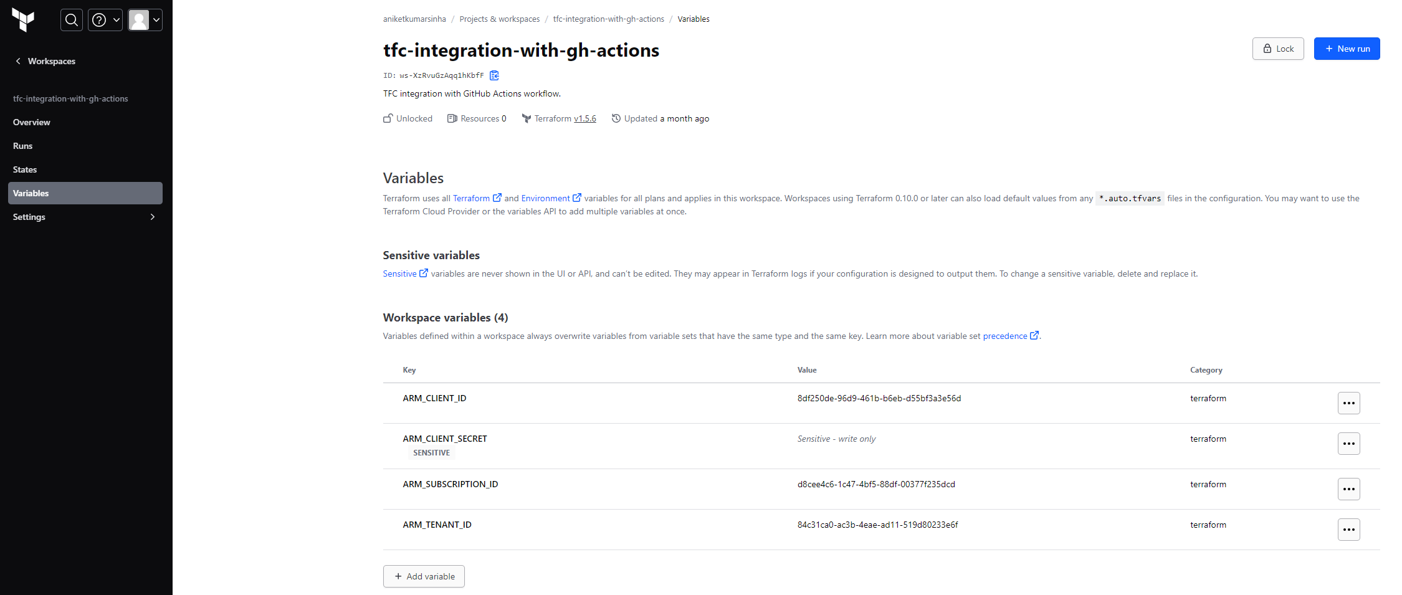
Integration Nirvana Steps
Add Azure details such as Subscription ID, Client ID, Client Secret, and Tenant ID in TFC workspace variables.

Slide 11
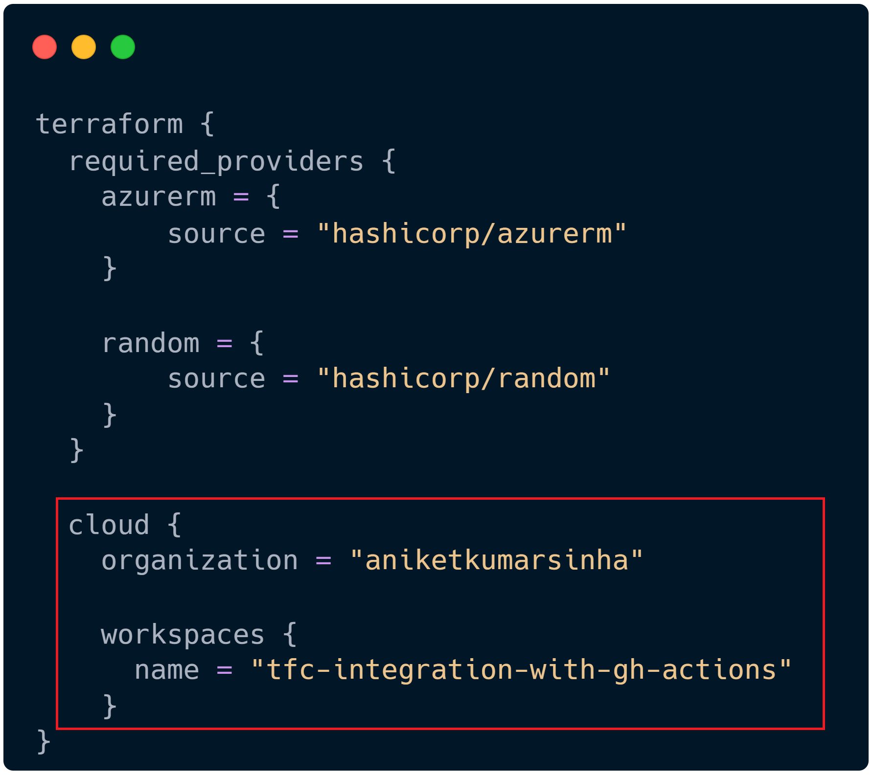
Integration Nirvana Steps
In your GitHub repository create main.tf file with some resource configuration.
Add terraform providers block with specific details of TFC workspace.

Slide 12
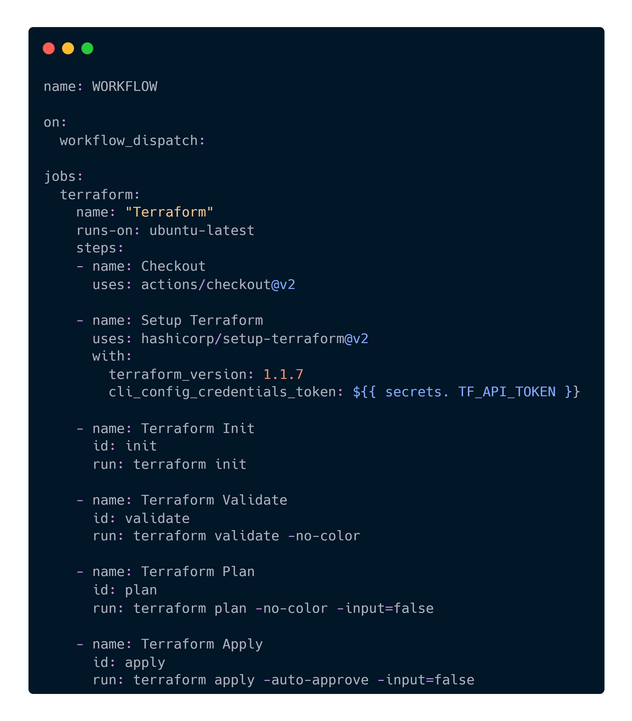
Integration Nirvana Steps
Create the GitHub Actions workflow file with Terraform steps (.github/workflows/deploy.yaml).

Slide 13
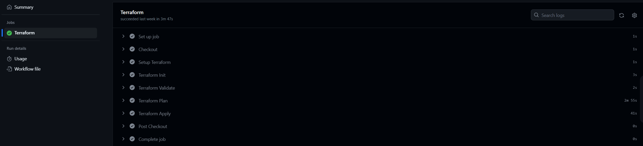
Deployment Show ✅
Notes:
Explain that the pipeline is not running twice, it’s showing the duplicate of TFC run.

Slide 14


Code repository
State file migration
bit.ly/tfc-integration-gh-action
bit.ly/tf-statefile-migration

Slide 15



Connect with me
Aniket Kumar Sinha
linktr.ee/aniketkumarsinha

Slide 16
Thank You
hugs@hashicorp.com | learn.hashicorp.com | discuss.hashicorp.com

